Slide 1
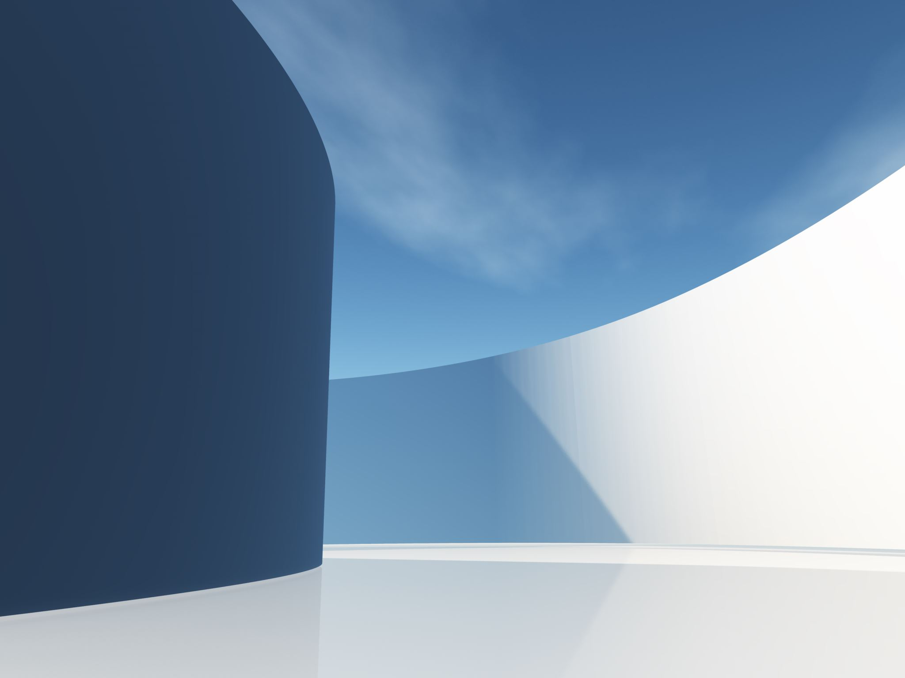
World Wireless Solutions (Mobile Version)
Presented By:
Armanpreet Kaur 4535488
JASDEEP KAUR 4535999
KESHAV SHARMA 4532854
SALONI BEDI 4531676

Slide 2

INDEX
INTRODUCTION
PROGRESS
WORKING MODEL DEMO AND LOGICS
CONCLUSION

Slide 3
Introduction
As mentioned in the earlier work, we have developed a mobile application/ mobile version for an existing website that is www.worldwirelesssolutions.com. To Commence with the previous version, the application was developed with the basic and static layout using containers and textboxes, and a single table used for data storage. However, the latest version not only has a modern look but also comes up with a greater number of screens to navigate which enhances the user’s experience by providing more information. Moreover, the latest version has got more space for data storage which reduces the risk of application crashing.

Slide 4
Progress 1.Quick Glance Screen 2.Modern Look to the existing screens 3.Our Process Screen 4.Meet the Team 5.Read More Screens

Slide 5
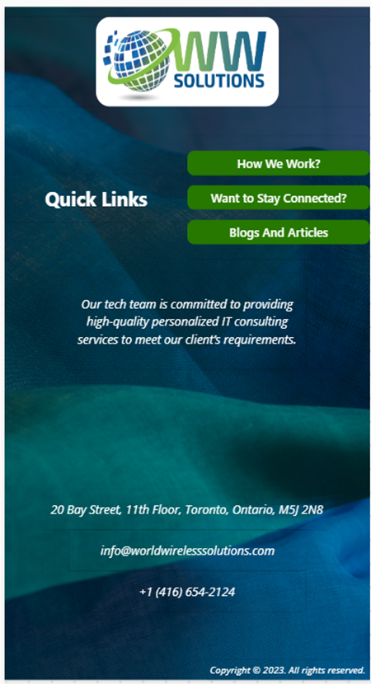
Quick Glance Screen
The latest version got a new look and a way to start the application by introducing the quick glance page. This page is designed specifically for the user who just wants to go through the application without entering the credentials

Slide 6
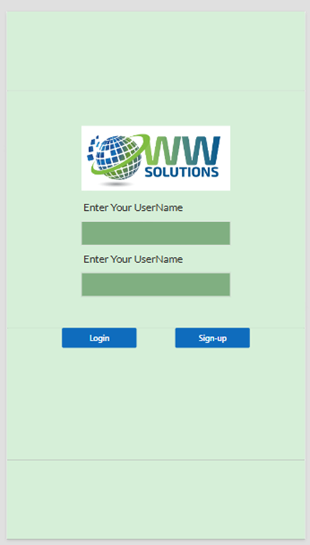
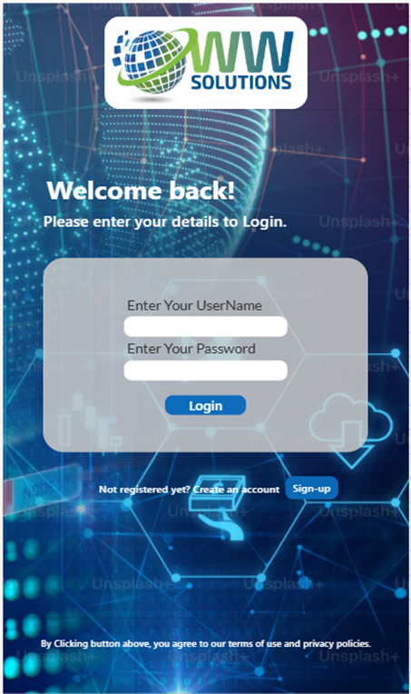
Login Screen
In the previous version, this screen used to be the startup screen for the application but in this version, it became the secondary screen. However, more information about the company can be found by entering the credentials on this screen

Slide 7
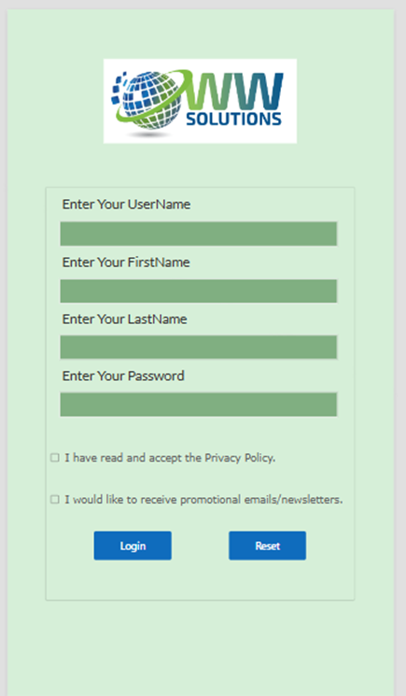
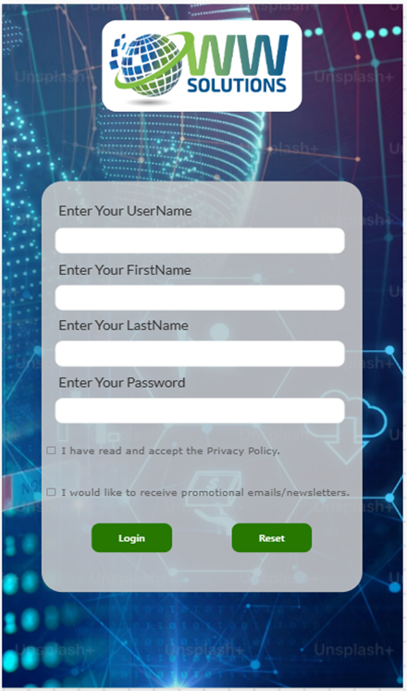
Sign-up Screen
This screen was developed for new users who can enter their details and are able to utilize the full information provided. By adding a few colors and pictures got this page a fresh visual.

Slide 8
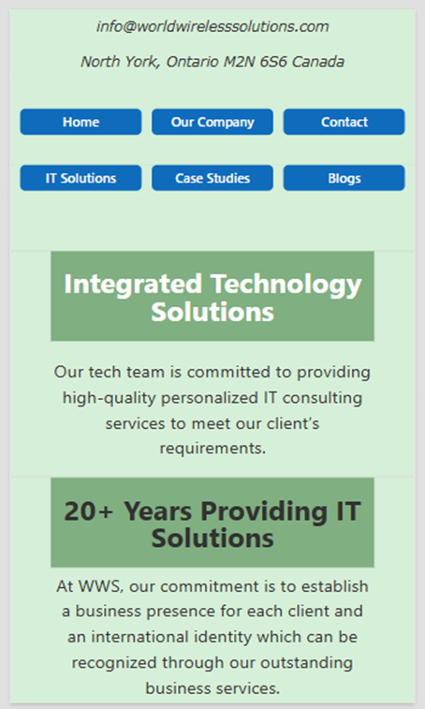

Home Page Screen
The most pertinent screen of the application helps in navigating to six different screens. As compared to the previous version this one got the new green color to all six buttons and rounded textboxes

Slide 9
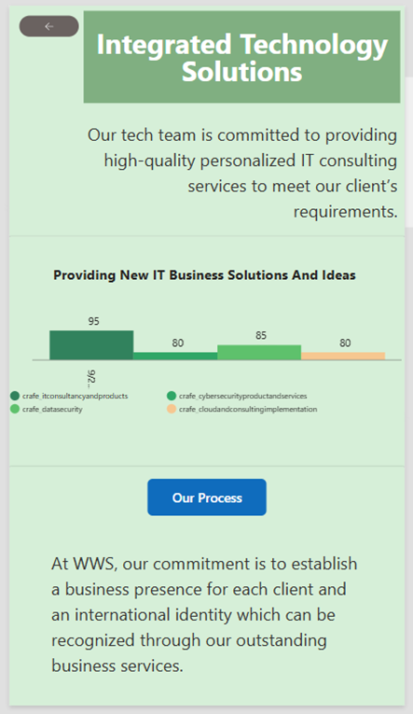
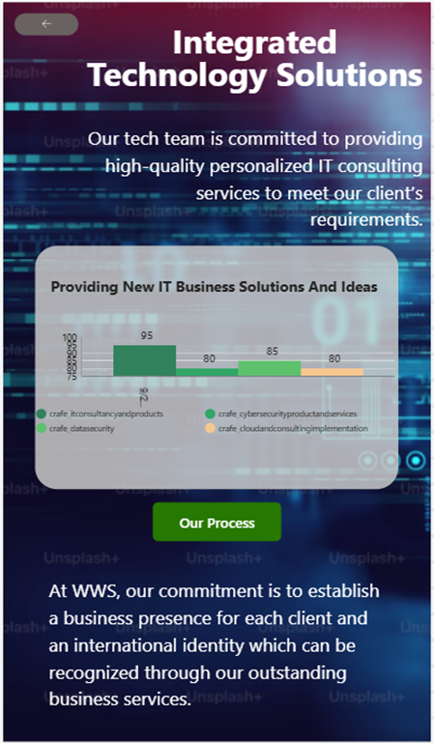
Home Button Screen
This screen has a graph and just below which lies a button which used to be static but, In this version, it got a functionality of navigating to the newly developed screen named “Our Process”

Slide 10

Our Process Screen
This page has the information regarding the process in which users get the solutions for their issues.

Slide 11
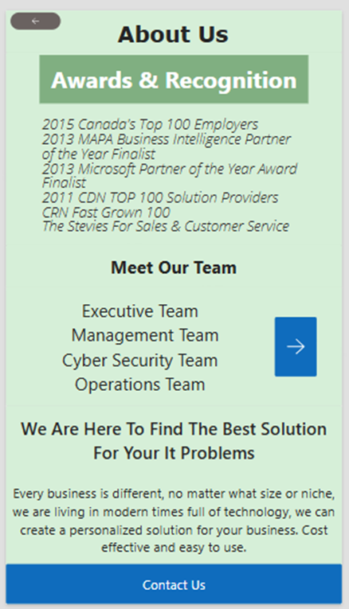
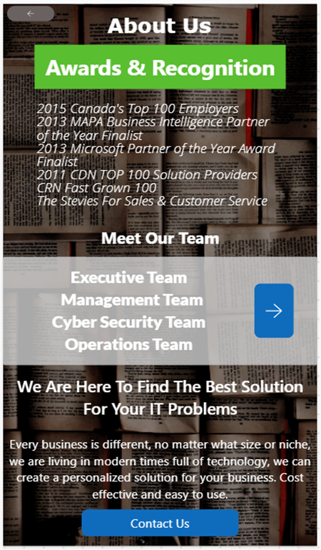
Our Company Screen
This screen was also having a static button in the center of the screen which is now functioning to the “Meet Our Team” page. However, the functioning of the contact us button at the bottom of the screen remains same with a new design.

Slide 12
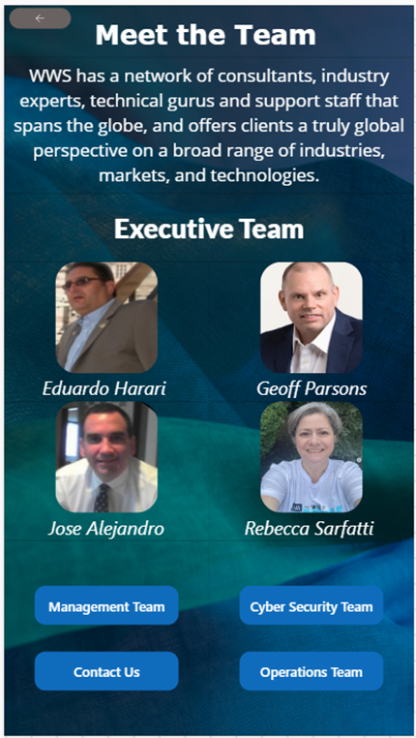
Meet the Team
It has a heading for the “Executive Team” along with some information about the same, the screen ends up with the four functionable buttons navigating to the “Management Team”, “Operations Team”, “Cyber Security Team” and the “Contact Us” Page.

Slide 13
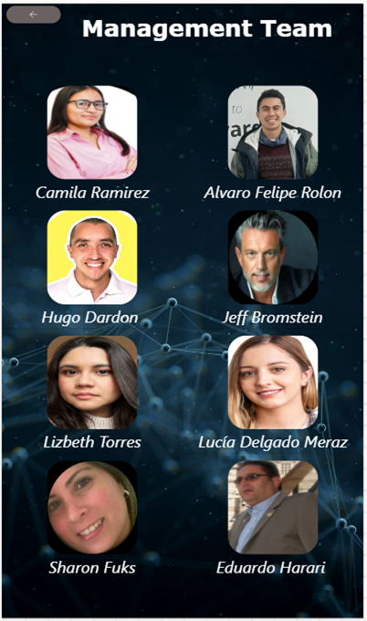
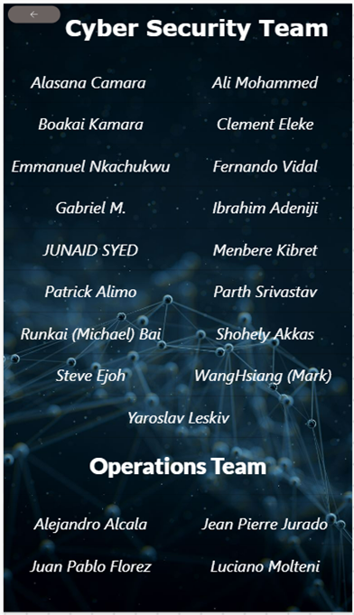
Team Members Screen
These page view users to see the team members of different departments like management, cyber security and operations that would be helping them.

Slide 14
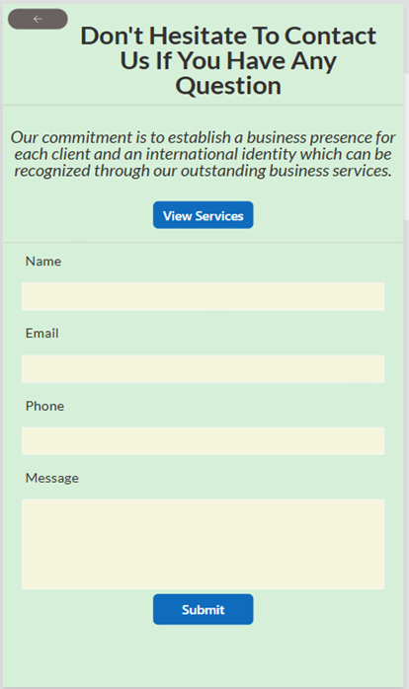
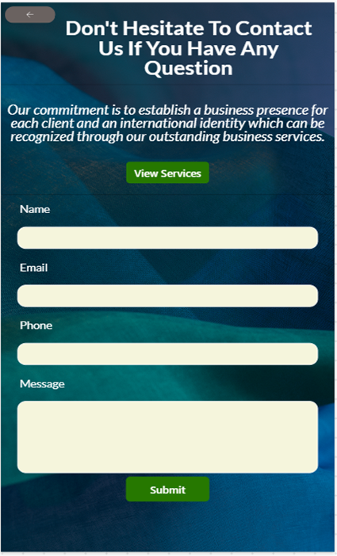
Contact Us Screen
This screen was developed having two static buttons view services and submit these are now functioned to navigating to the “IT Solutions” Page and storing data in the database on clicked respectively.

Slide 15
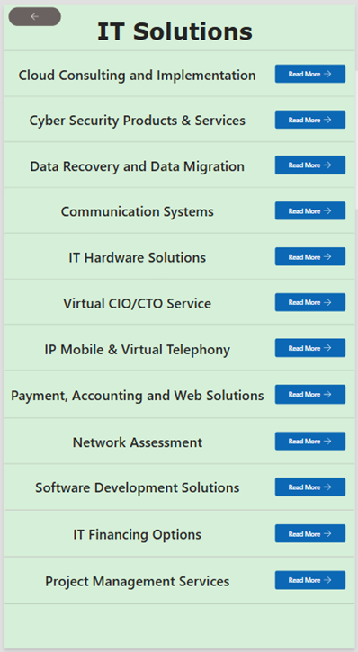
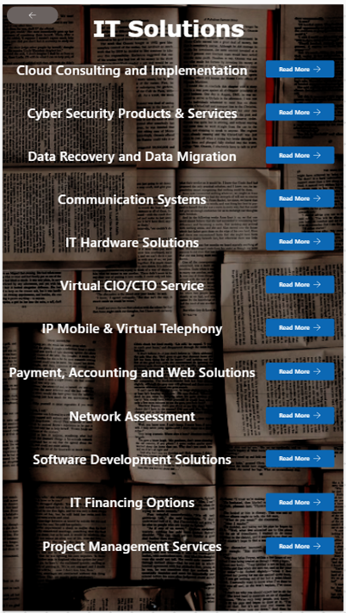
IT solutions Screen
This screen was designed to provide information on what kind of services are available in the company. Now users can access the full information about specific service by clicking the “Read More” button respective to the heading.

Slide 16
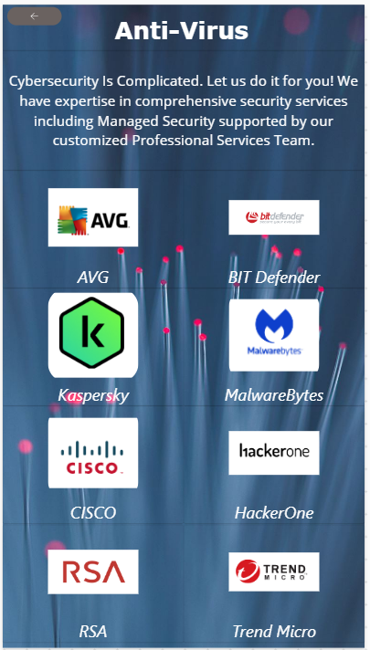
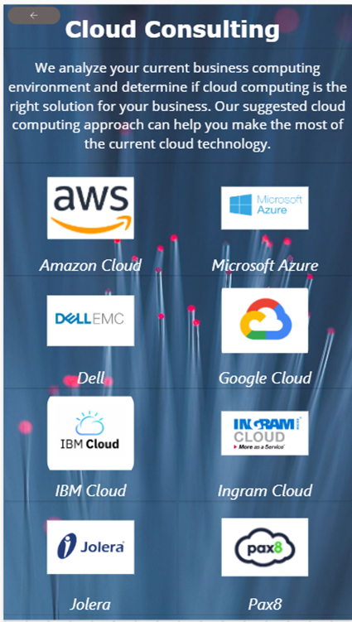
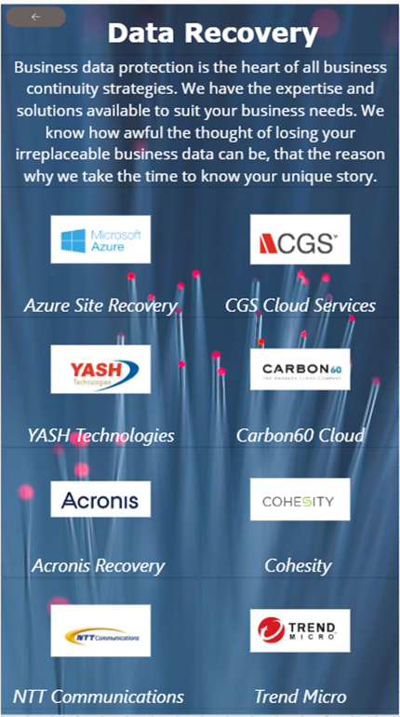
Glance at the screens by clicking the Read More button

